Slide 1
SEARCHING
THE MASTER AND DOCTORAL THESES
MADE IN
MIDDLE EAST TECHNICAL UNIVERSITY
ODTÜ Library, March 2016

Slide 2
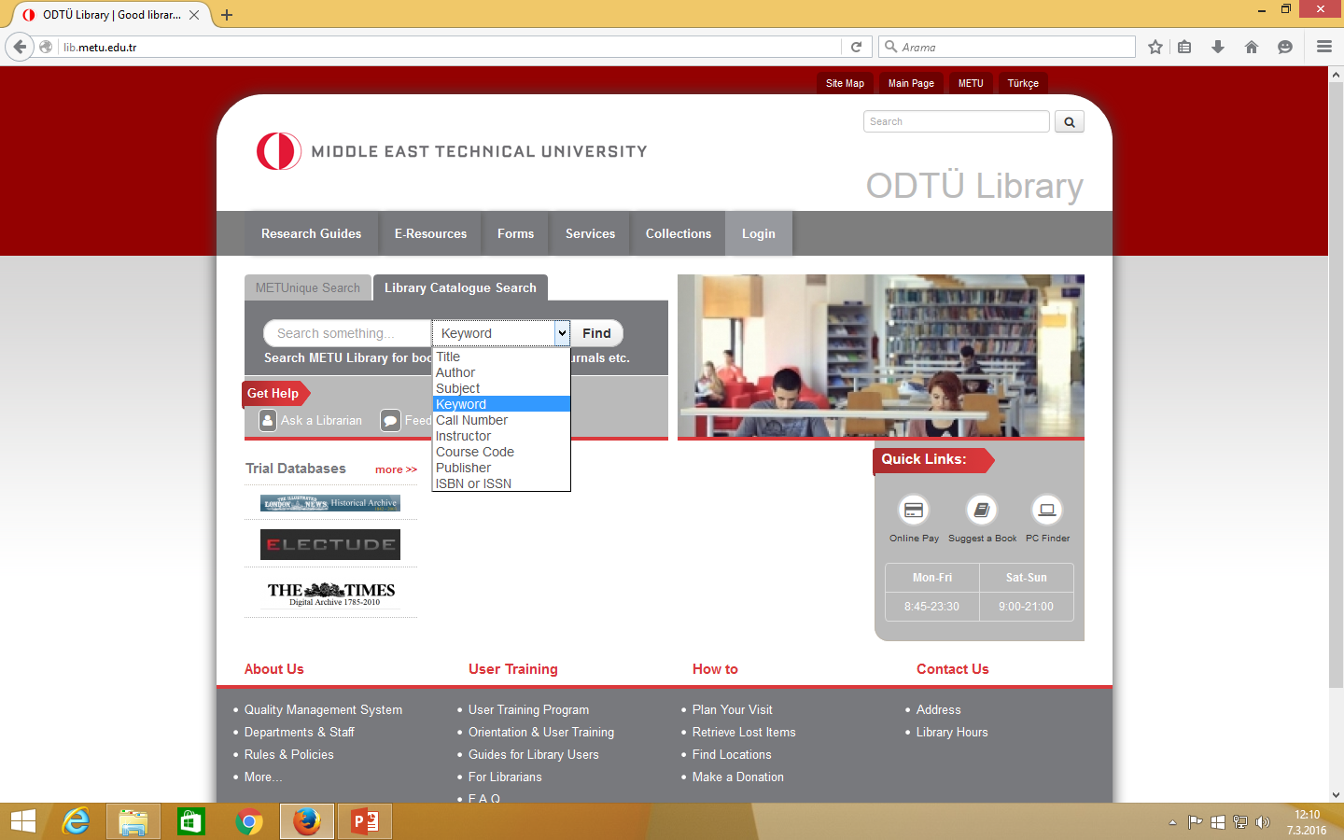
Please write something in the box at Library Catalog Search area and chose a criteria from the list, then click on the Find button (write the surname first for author search).

Slide 3
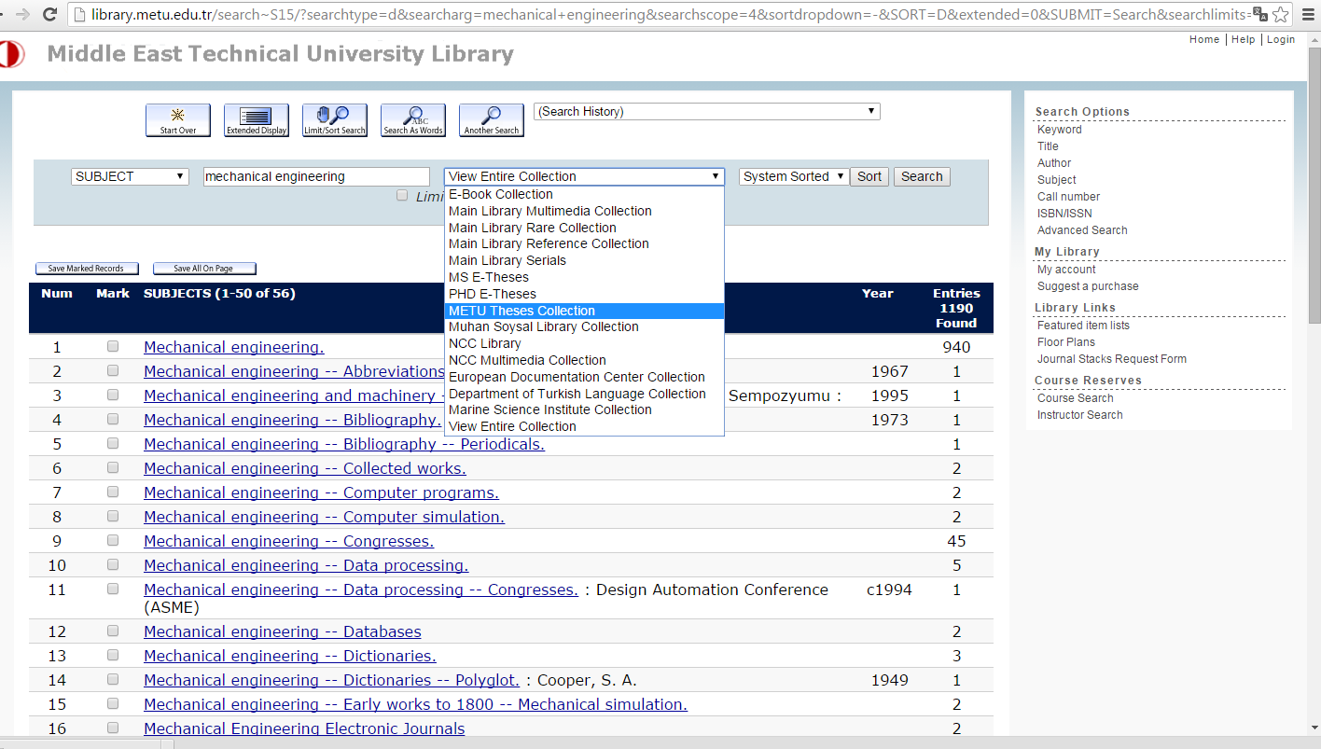
Chose METU Theses Collection criteria in the catalog and click on the Search button.

Slide 4
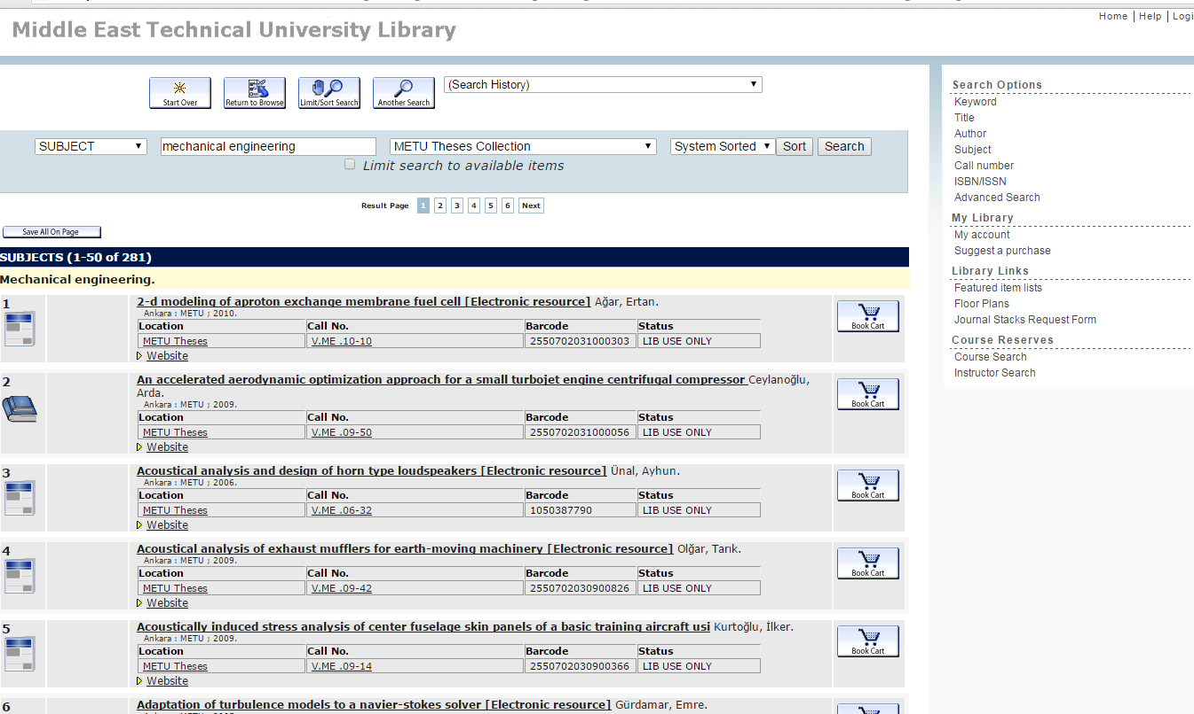
Click on the title to see the bibliographic record.

Slide 5
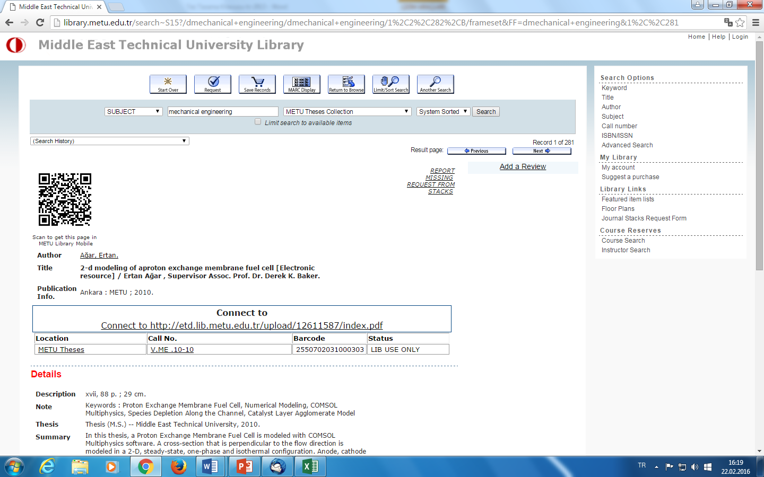
You can access the thesis you need by clicking on the link in the bibliographic record. If not, accessing the thesis is not permitted by the author.

Slide 6
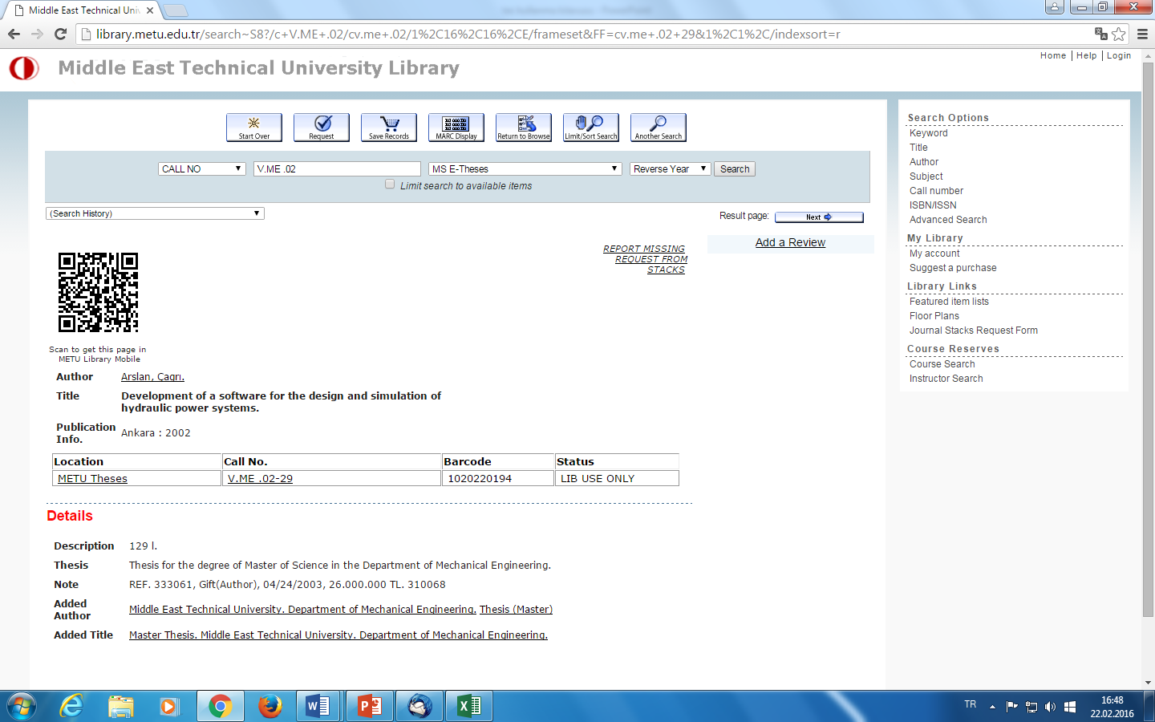
Click on the Request From Stacks link for the thesis in only printed format.

Slide 7
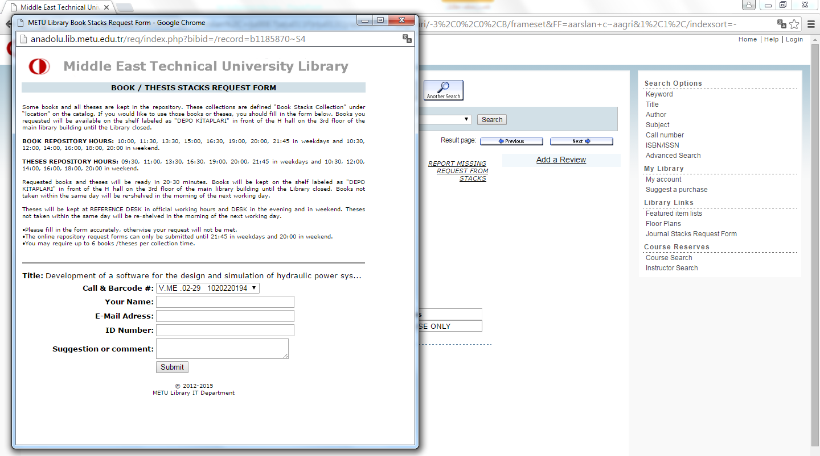
Please fill in the form after reading the Theses Repository Hours and apply to the librarian(s) at
Reference desk.

